Slide 1
创新研究课程 科研项目短课

Slide 2
Course Syllabus 课程大纲
Content 内容 | 课时 | 课程说明 | 课后练习 | 备注
Version control – Git & Github, learn to write ReadMe | 3 |  | Write a readme file and upload to Github | README: https://classroom.udacity.com/courses/ud777 Git: https://classroom.udacity.com/courses/ud123 Github: https://classroom.udacity.com/courses/ud456 https://classroom.udacity.com/courses/ud775
Latex for scientific writing | 3 |  | Download CVPR latex template and upload to Github | The Not So Short Introduction to Latex (PDF)
Python tutorial | 3 |  | Finish a demo script and upload to Github | http://cs231n.github.io/python-numpy-tutorial/
Computer Vision and Opencv | 3 |  | Finish a demo script and upload to Github | http://cs231n.stanford.edu/ https://docs.opencv.org/3.4/d9/df8/tutorial_root.html https://www.pyimagesearch.com/2014/11/17/non-maximum-suppression-object-detection-python https://www.pyimagesearch.com/2015/02/16/faster-non-maximum-suppression-python/
Viola-Jones face recognition | 3 |  | Final assignment | https://docs.opencv.org/3.4/d7/d8b/tutorial_py_face_detection.html
Introduction to deep learning | 3 |  | -- | https://www.coursera.org/learn/ai-for-everyone/

Slide 3
Today’s agenda:
Python Recursion Learning
Computer vision overview & historical context
Introduction of OpenCV
Case study: Non-maximum Suppression (NMS)

Slide 4
Computer Vision overview & Historical context

Slide 5
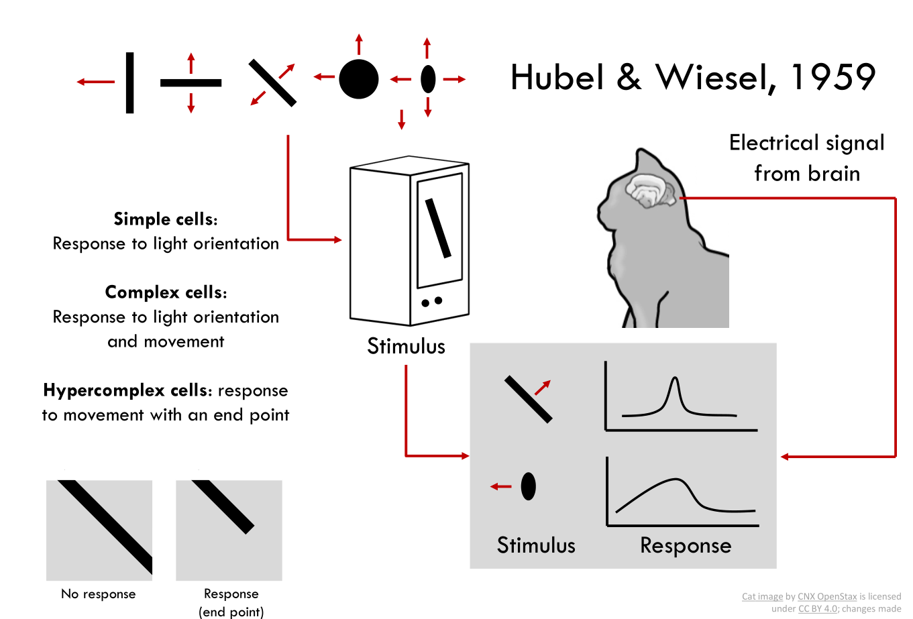

Slide 6
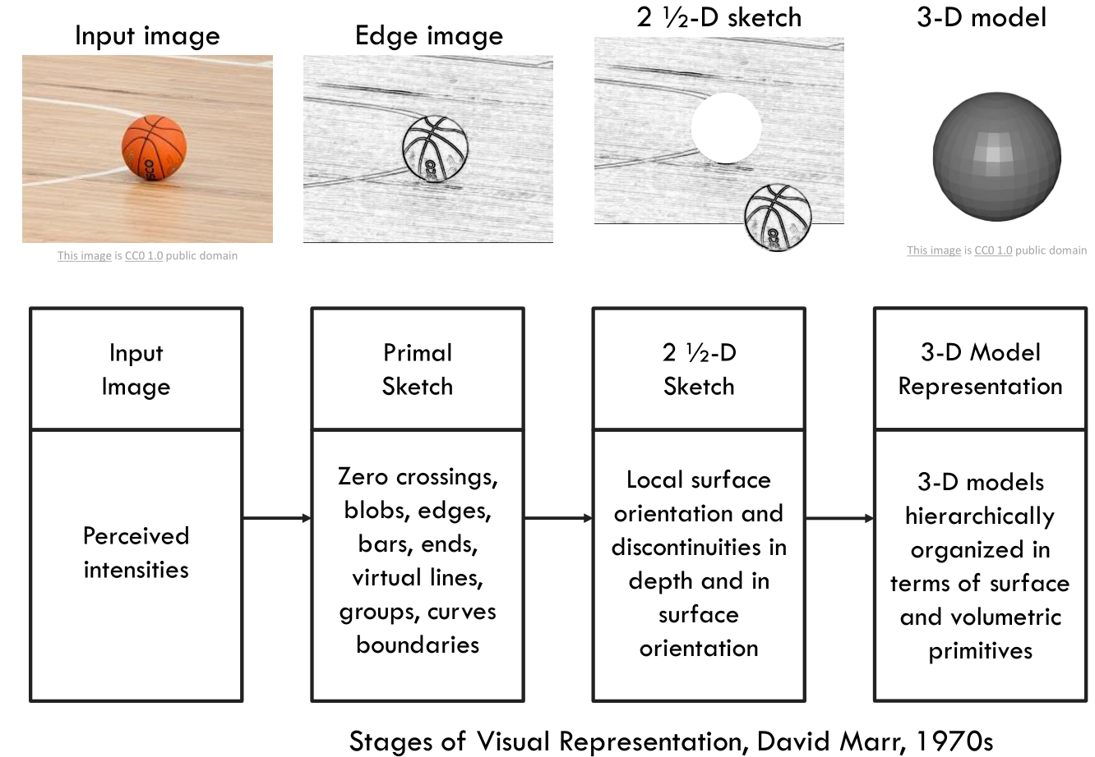

Slide 7
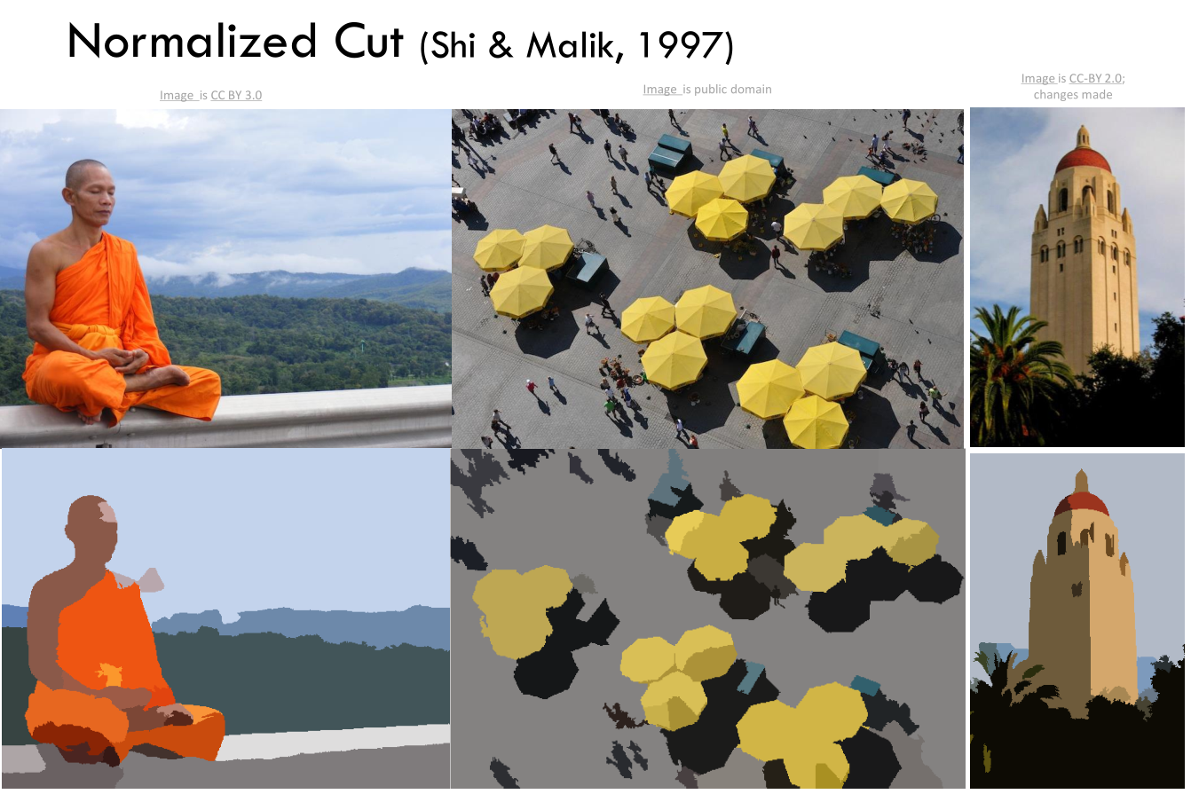

Slide 8
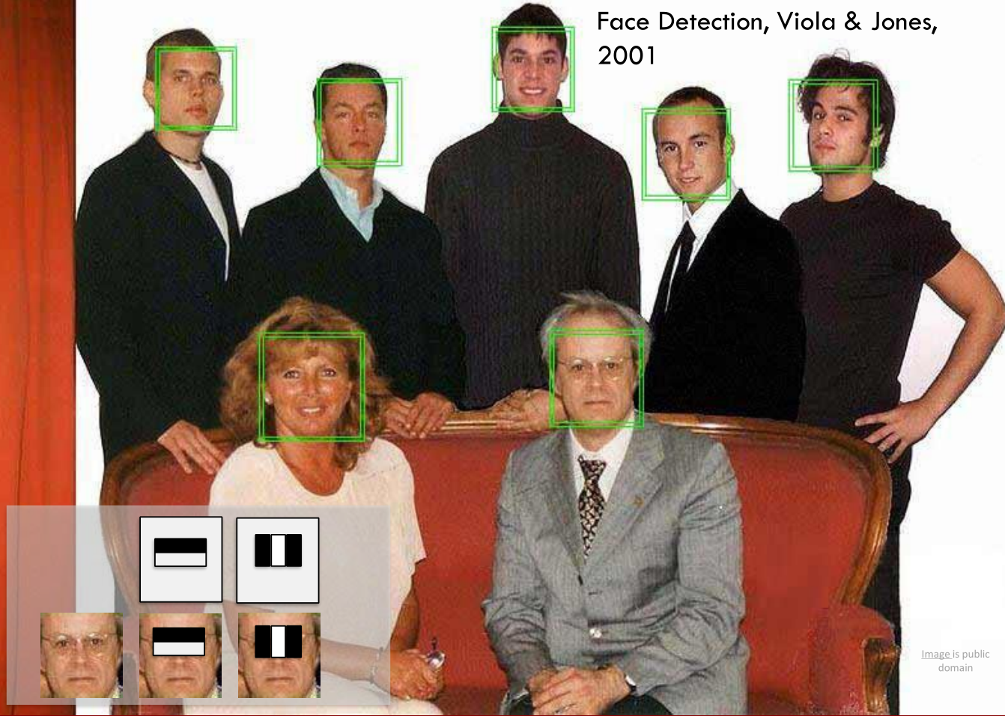

Slide 9
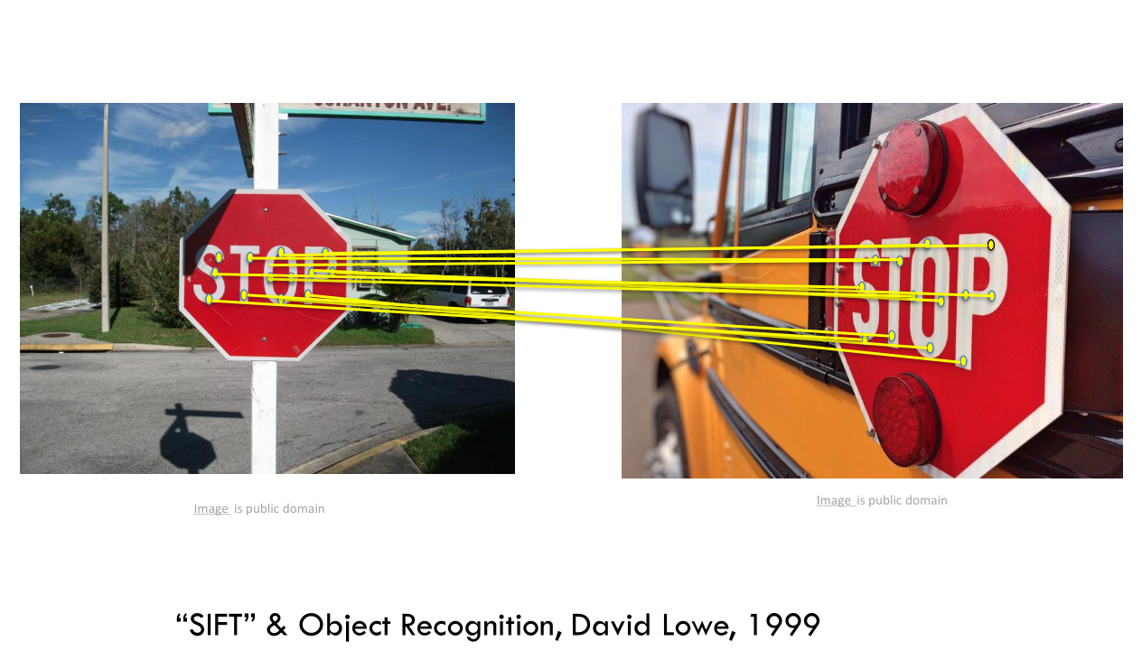

Slide 10
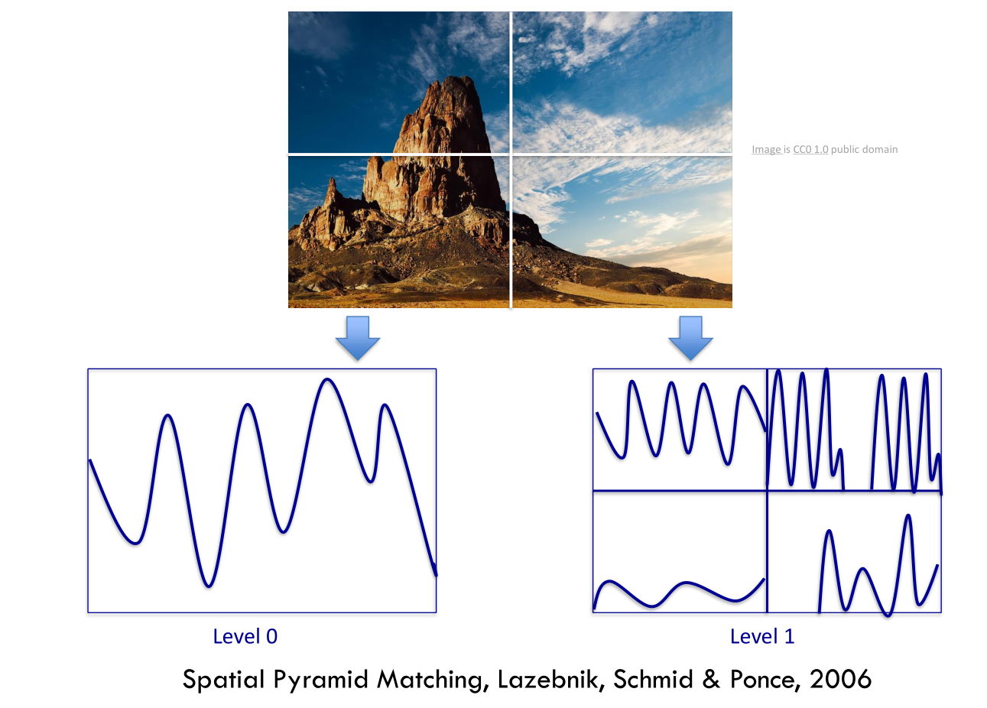

Slide 11
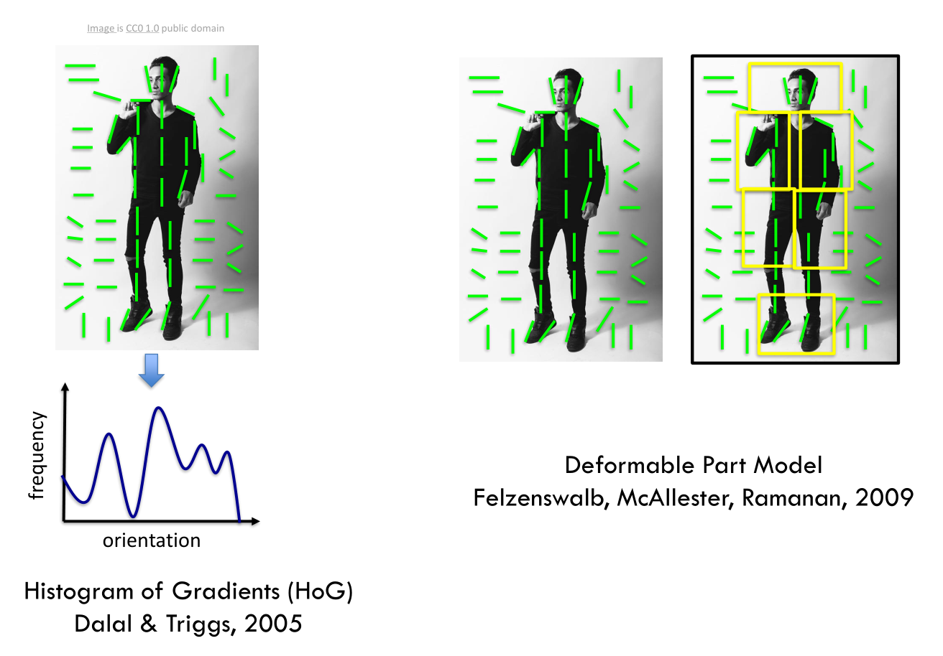

Slide 12
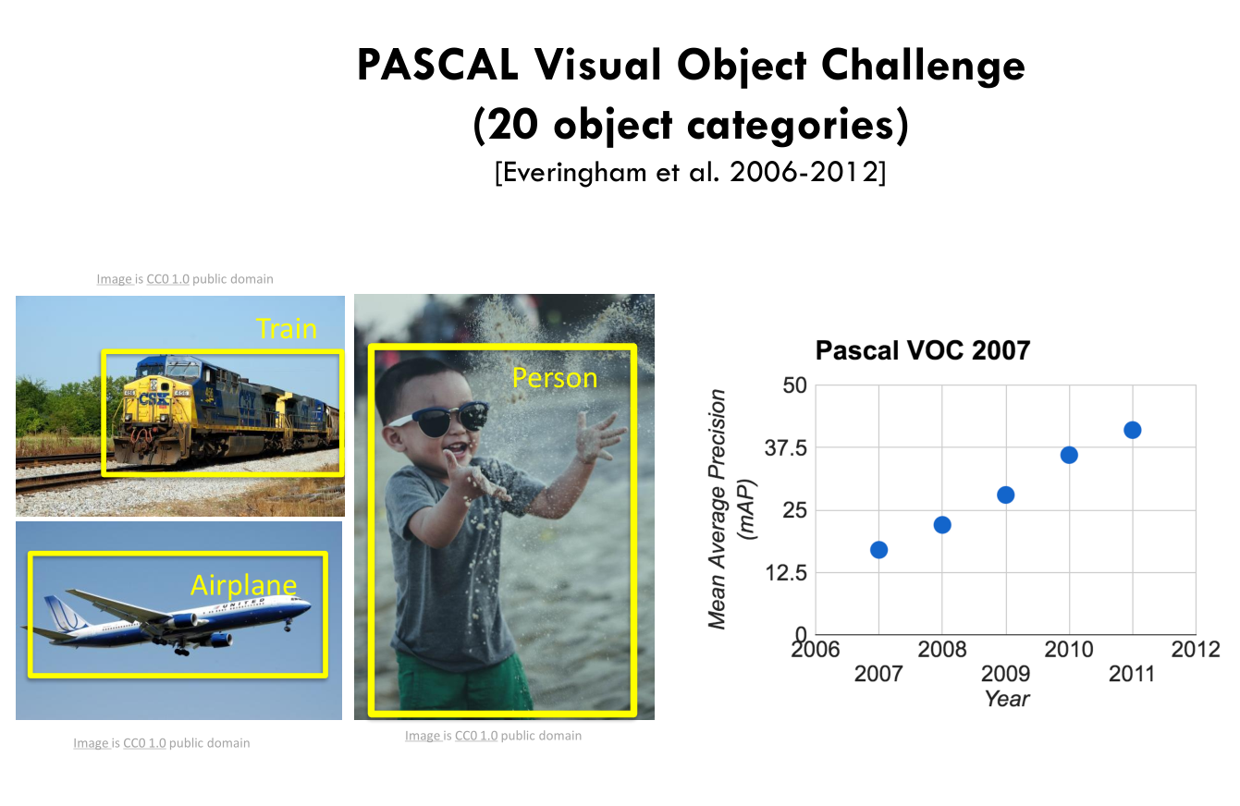

Slide 13
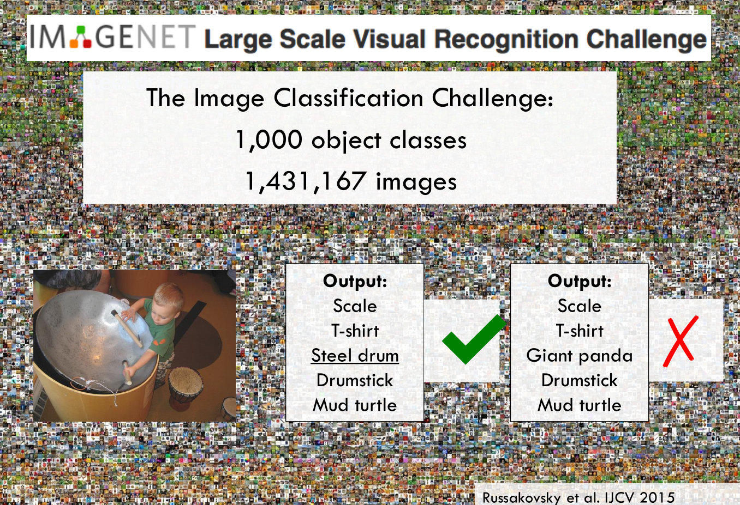

Slide 14
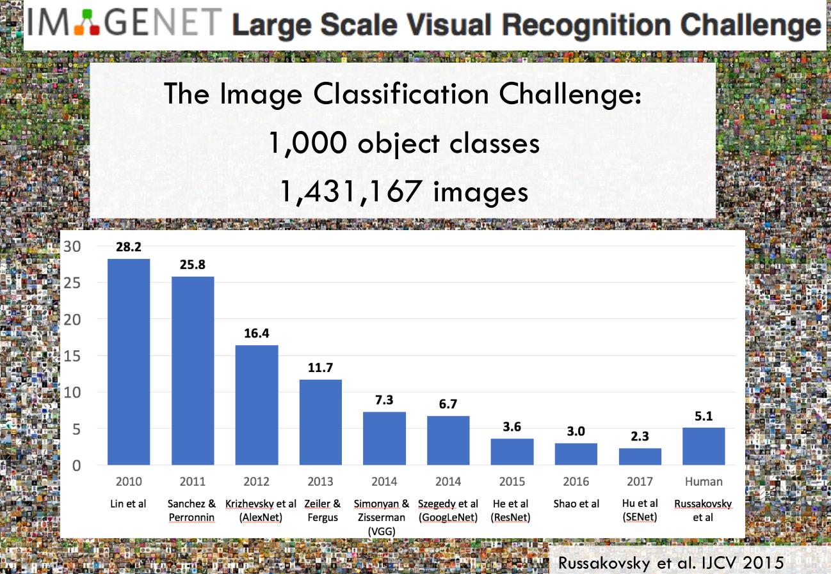

Slide 15
There are many visual recognition problems that are related to image classification, such as object detection, image captioning

Slide 16
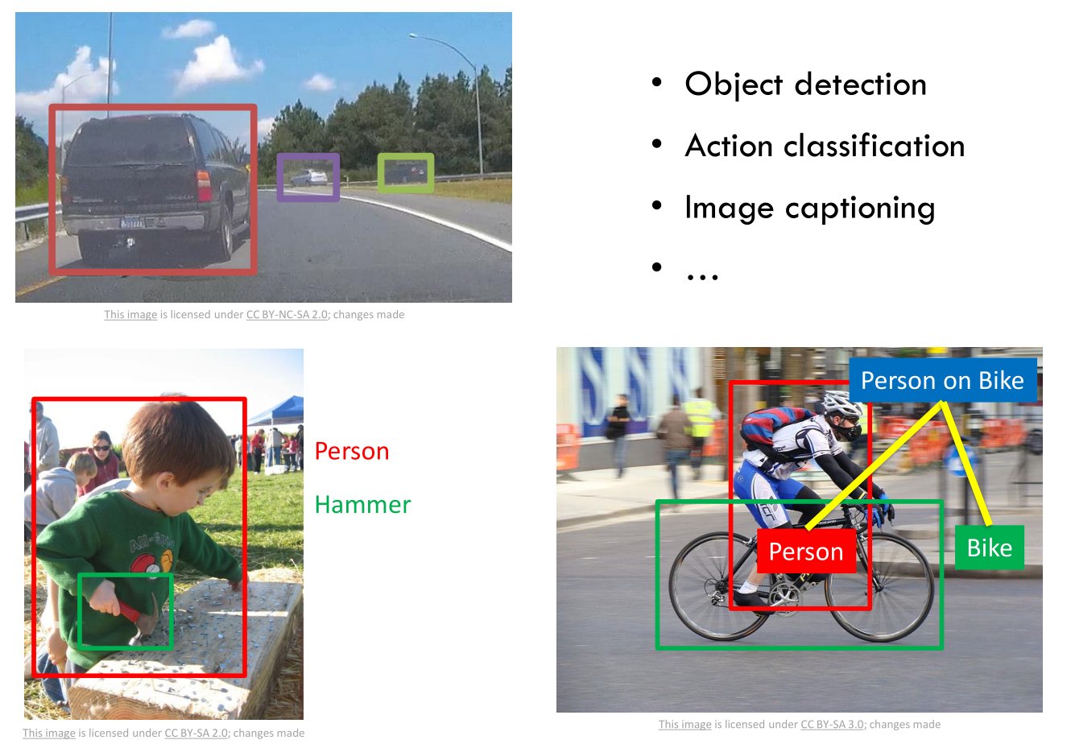

Slide 17
Convolutional Neural Networks (CNN) have become an important tool for object recognition

Slide 18
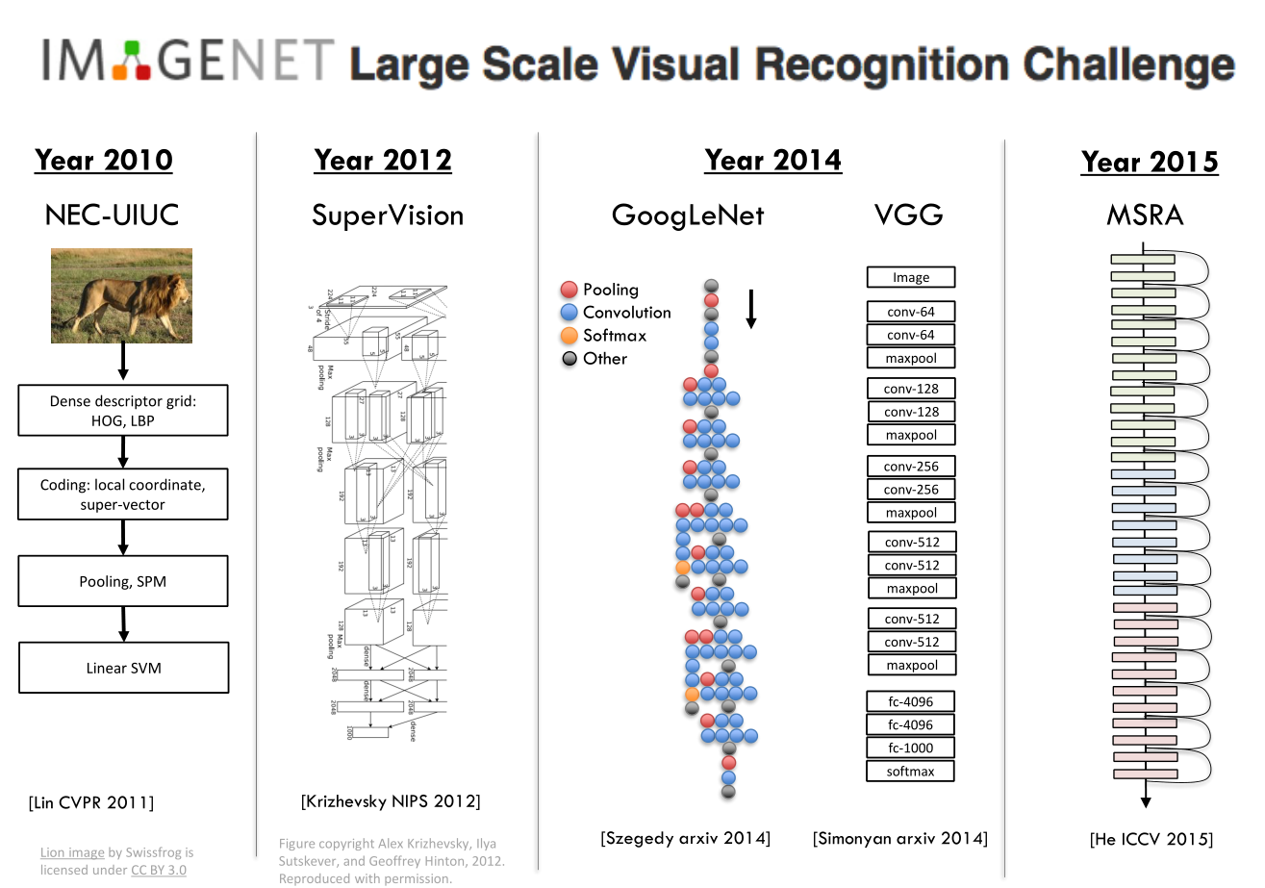

Slide 19
OpenCV tutorial
https://opencv-python-tutroals.readthedocs.io/en/latest/py_tutorials/py_tutorials.html

Slide 20
Non-Maximum Suppression for Object Detection
https://www.pyimagesearch.com/2014/11/17/non-maximum-suppression-object-detection-python

Slide 21
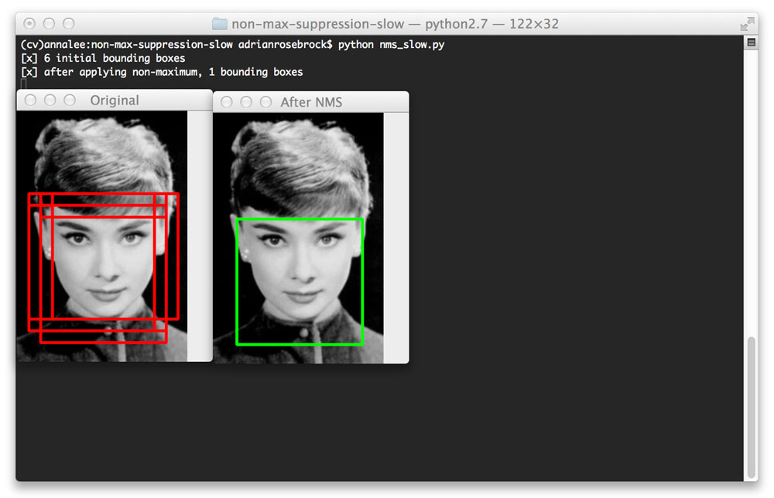
Histogram of Oriented Gradients for Objection Detection
Sampling positive images
Sampling negative images
Training a Linear SVM
Performing hard-negative mining
Re-training your Linear SVM using the hard-negative samples
Evaluating your classifier on your test dataset, utilizing non-maximum suppression to ignore redundant, overlapping bounding boxes

Slide 22

IoU: Intersection Over Union

Slide 23
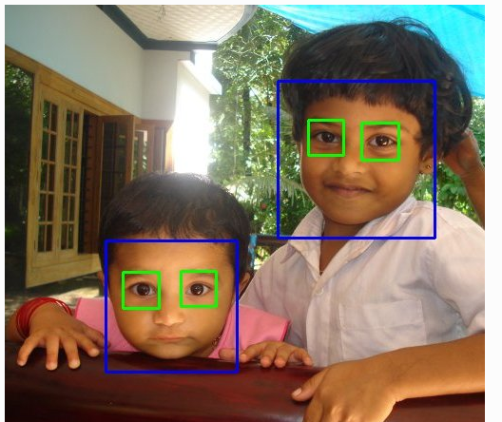
Assignment
Take a photo of yourself.
Upload the OpenCV face detected photo and name it as “your_name.py” (Di_WU.py” ) to the AI_Precourse\Week4_OpenCV folder
Push the new change to your “origin” repo and create a pull request so that you change will be seen by the “upstream”

